Slide 1

RUNGTA COLLEGE OF DENTAL SCIENCES & RESEARCH
DENTAL CARIES
DEPARTMENT OF PEDODONTICS AND PREVENTIVE DENTISTRY

Slide 2
Specific learning Objectives
Core areas | Domain
Introduction Classification of caries Epidemiology of caries | Saliva and dental caries Diet and dental caries.

Slide 3
CATEGORY
MUST TO KNOW
NICE TO KNOW
Food and sugar substitutes.
DESIRE TO KNOW
Caries vaccine
Theories of dental caries
Current concept of dental caries.
Global decline in dental caries.

Slide 4
CONTENTS
Introduction
Classification of caries
Epidemiology of caries
Theories of dental caries
Histology of dental caries
Saliva and dental caries
Diet and dental caries
Food and sugar substitutes
Caries vaccine
Global decline in dental caries

Slide 5
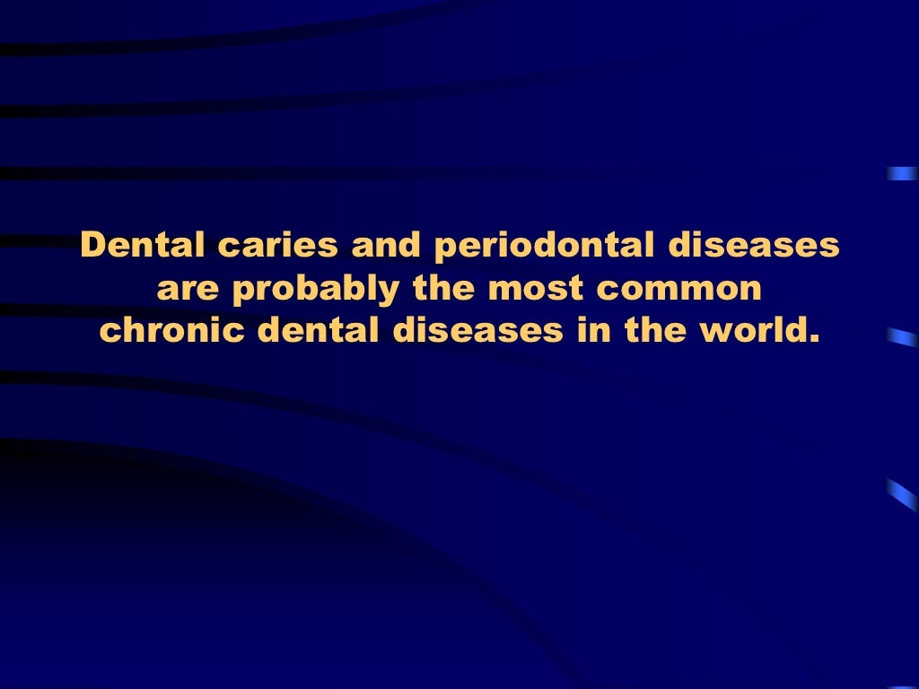

Slide 6
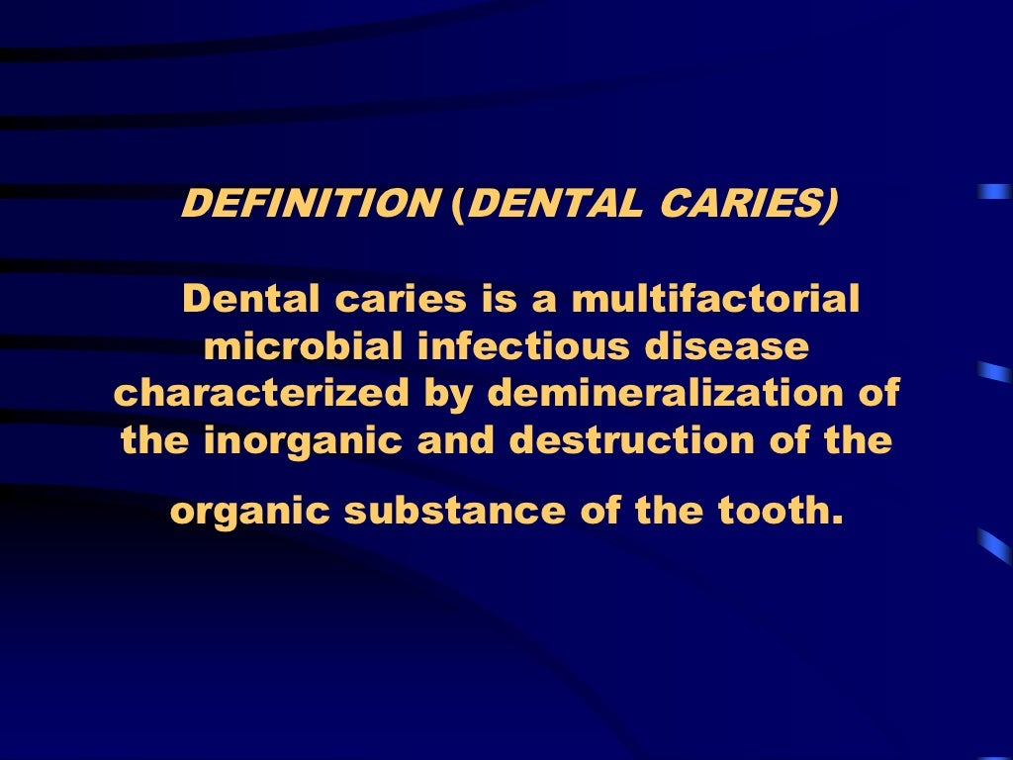

Slide 7
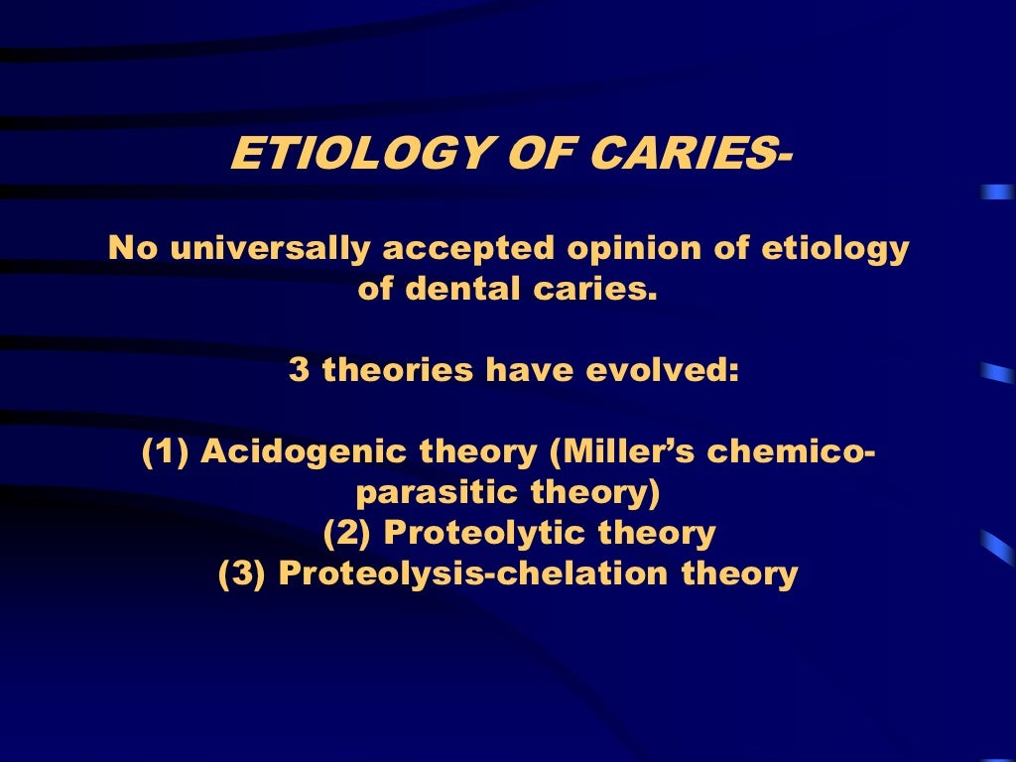

Slide 8
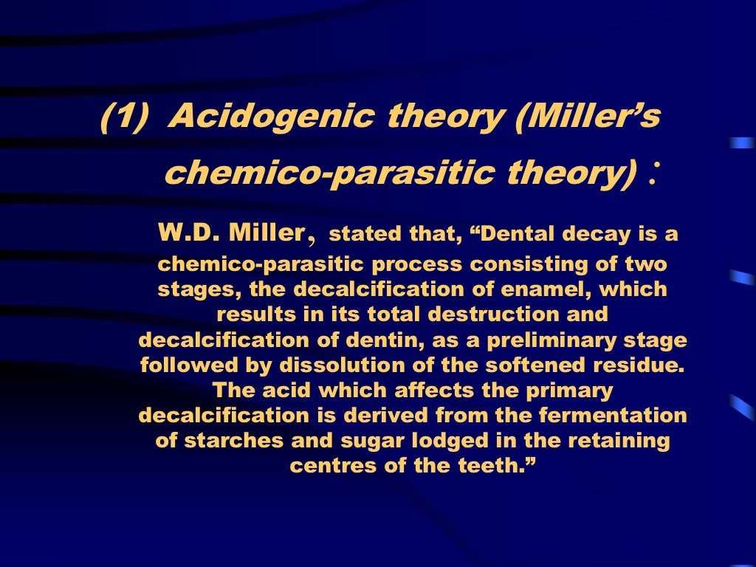

Slide 9
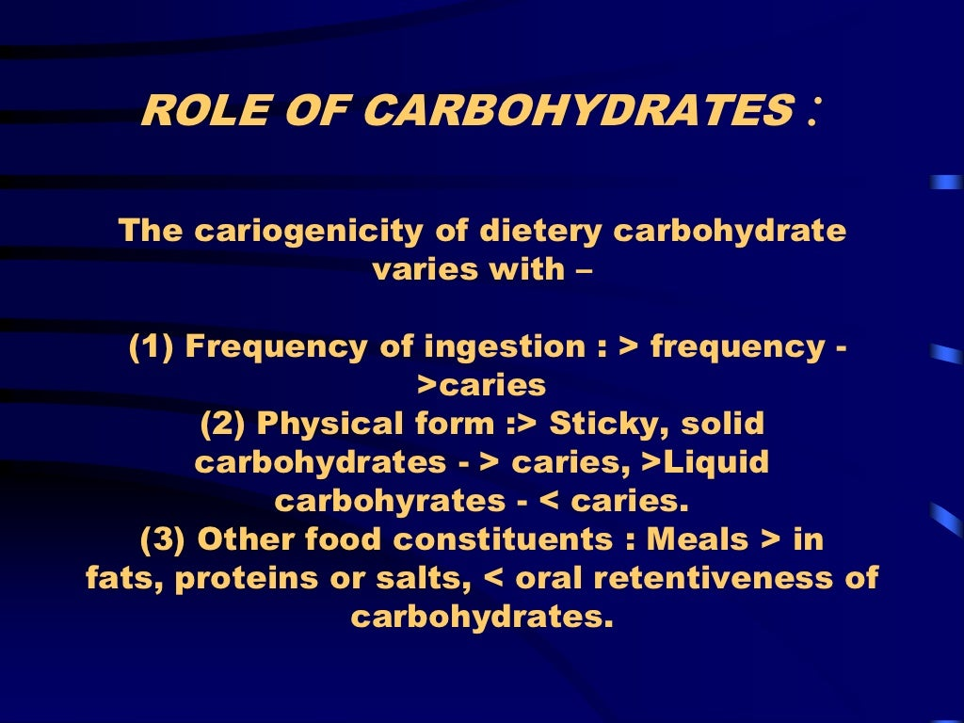

Slide 10
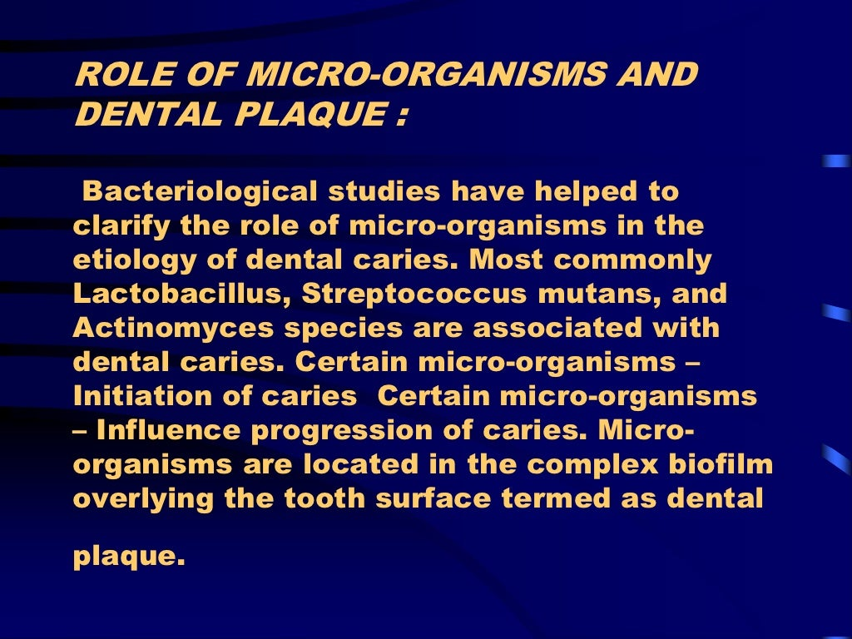

Slide 11
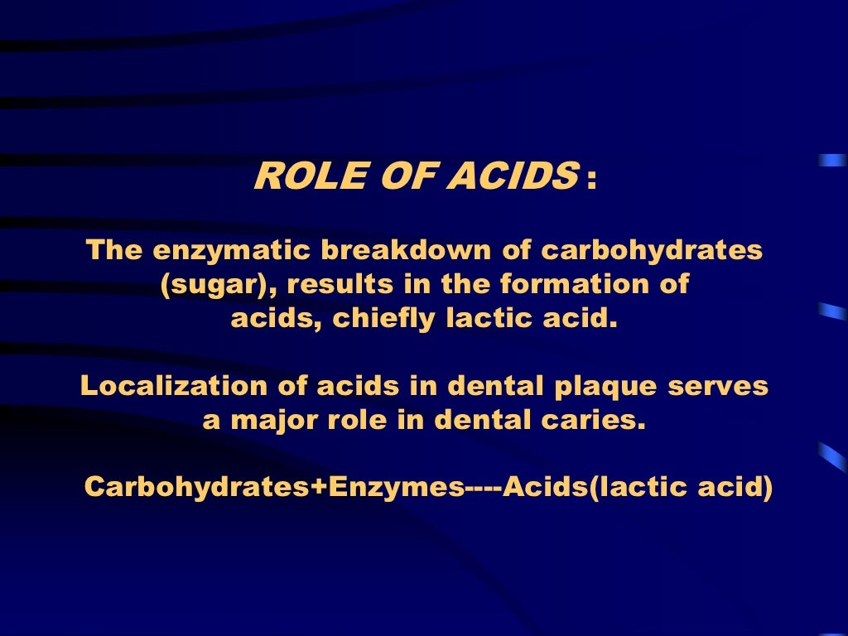

Slide 12
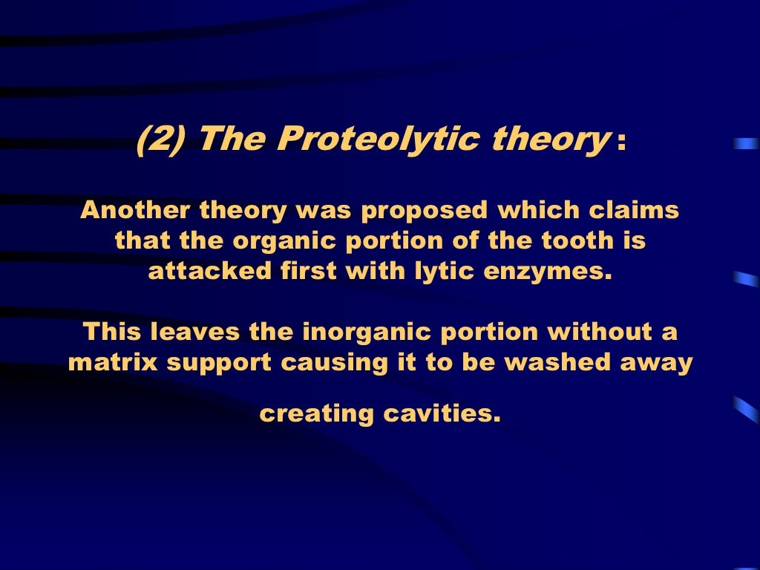

Slide 13
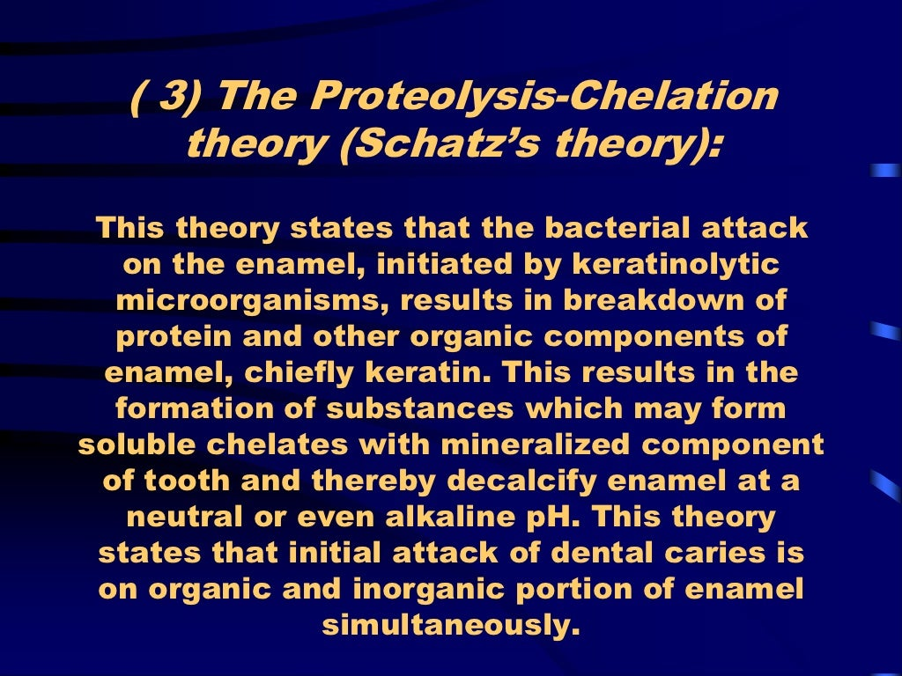

Slide 14
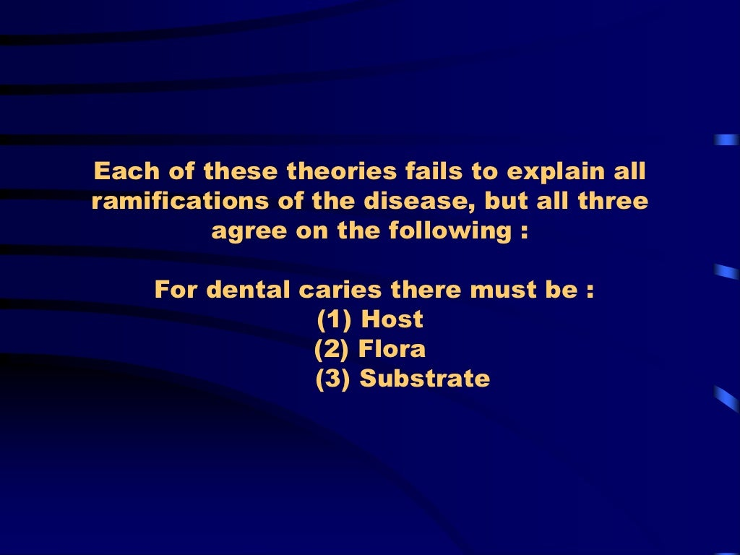

Slide 15
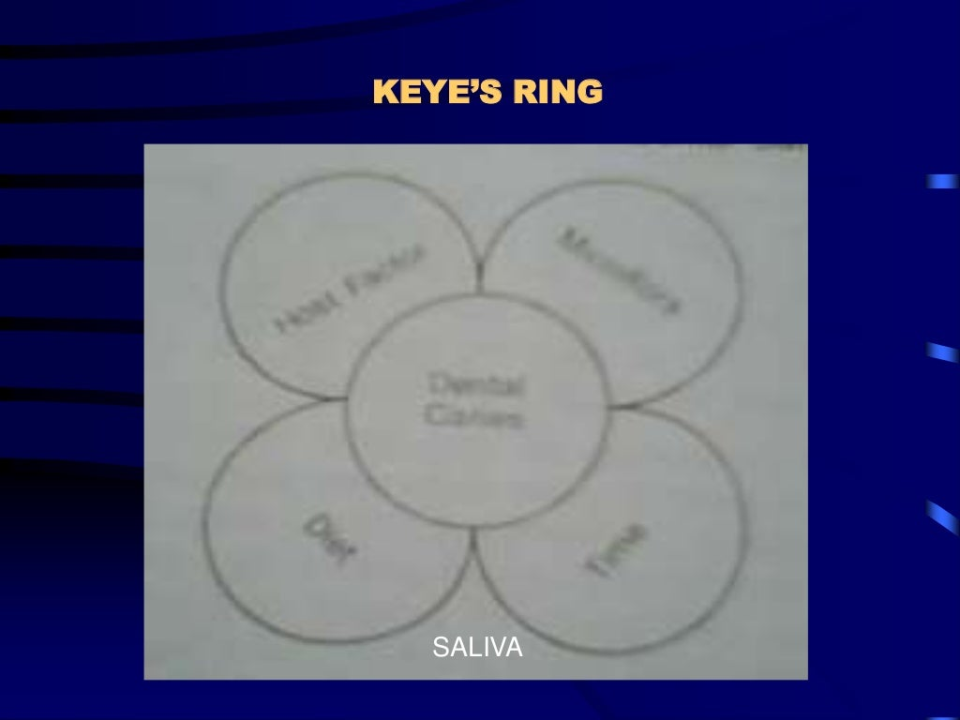

Slide 16
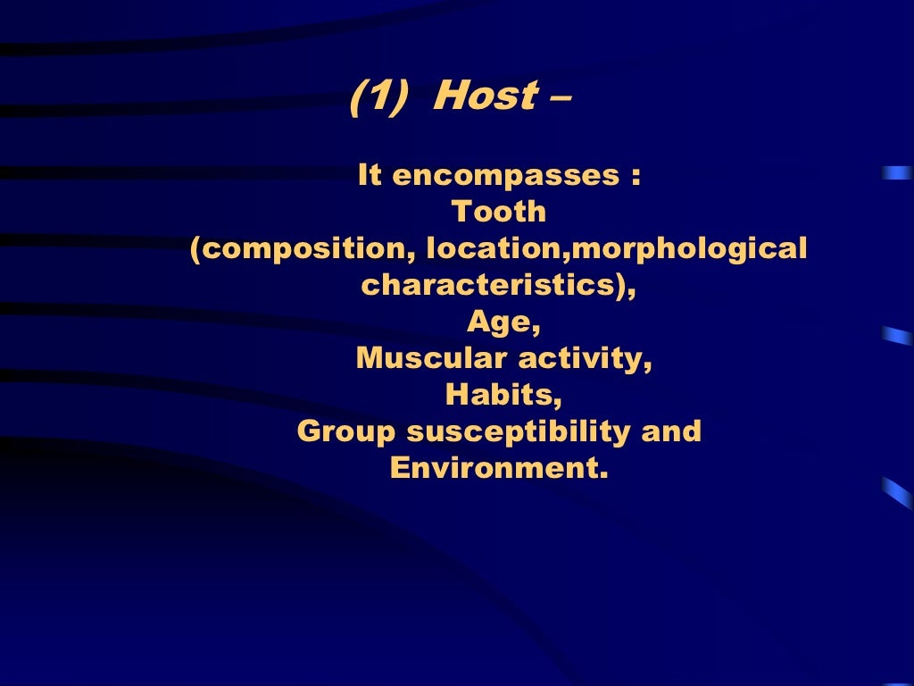

Slide 17
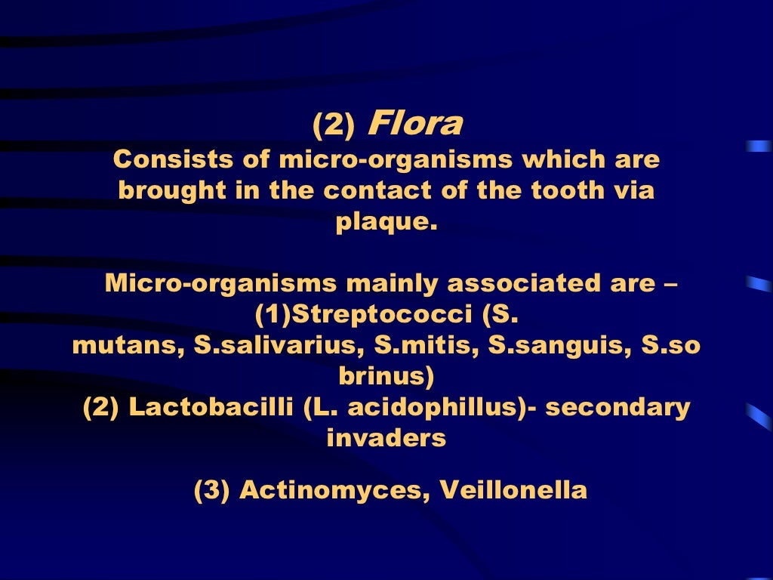

Slide 18
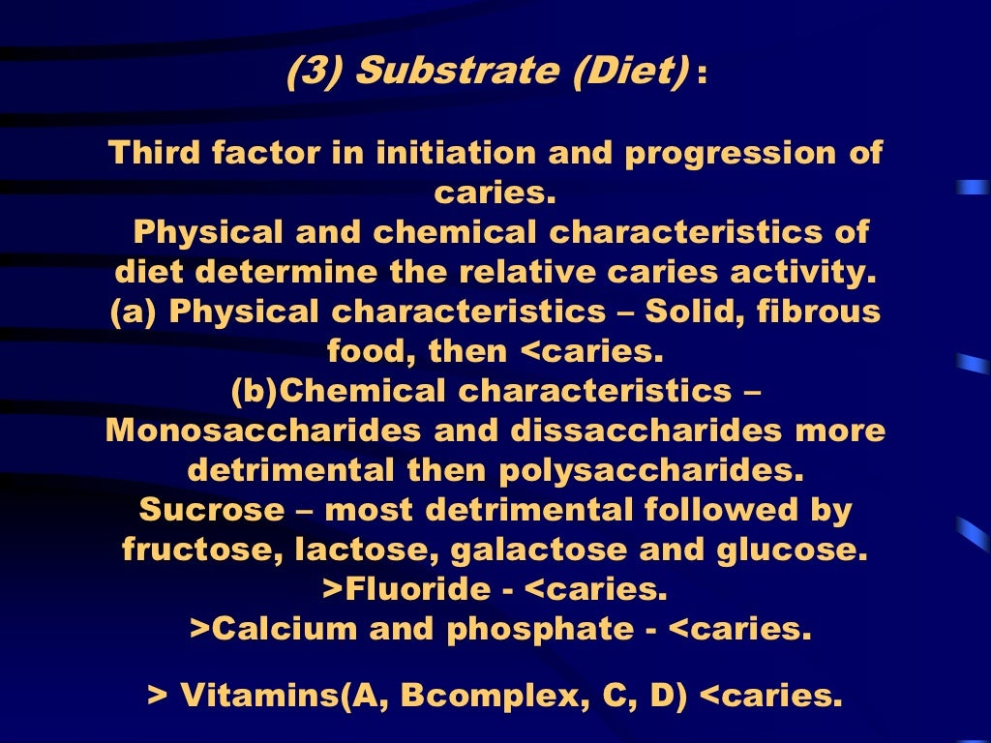

Slide 19
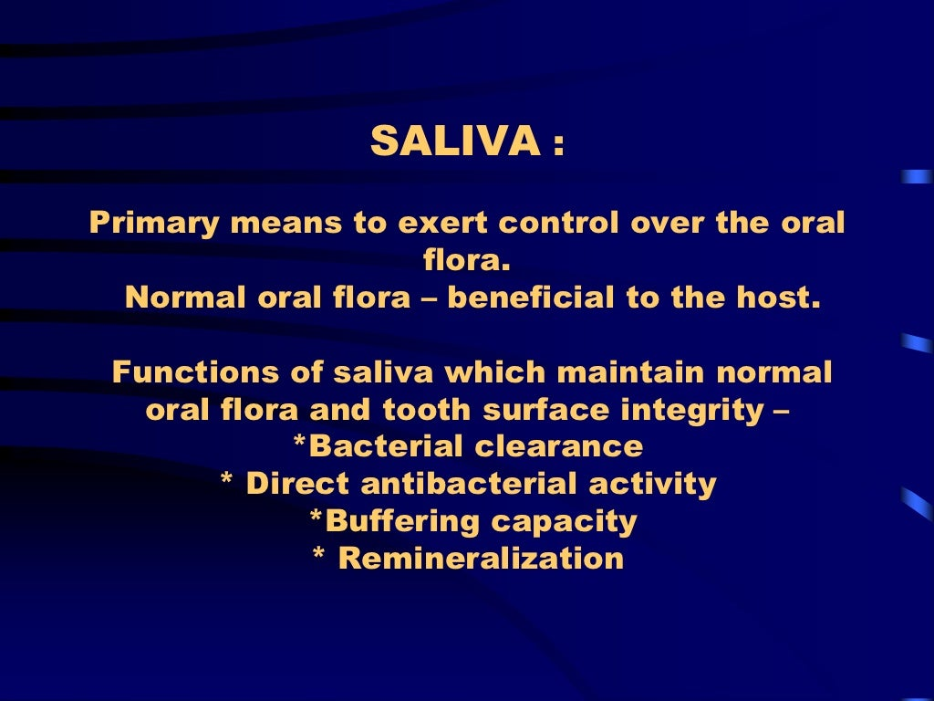

Slide 20
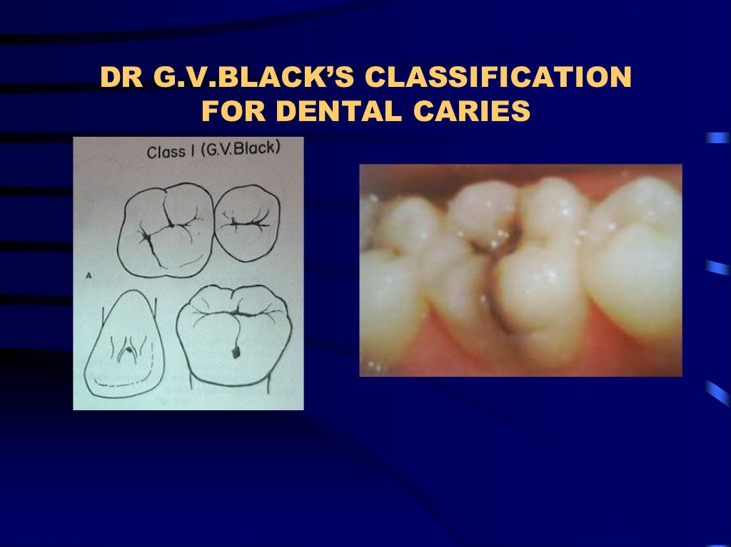

Slide 21
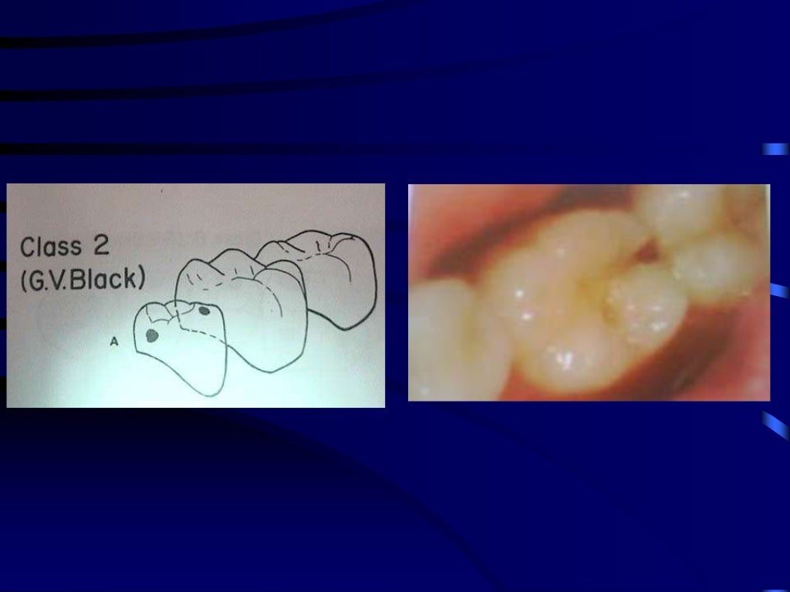

Slide 22
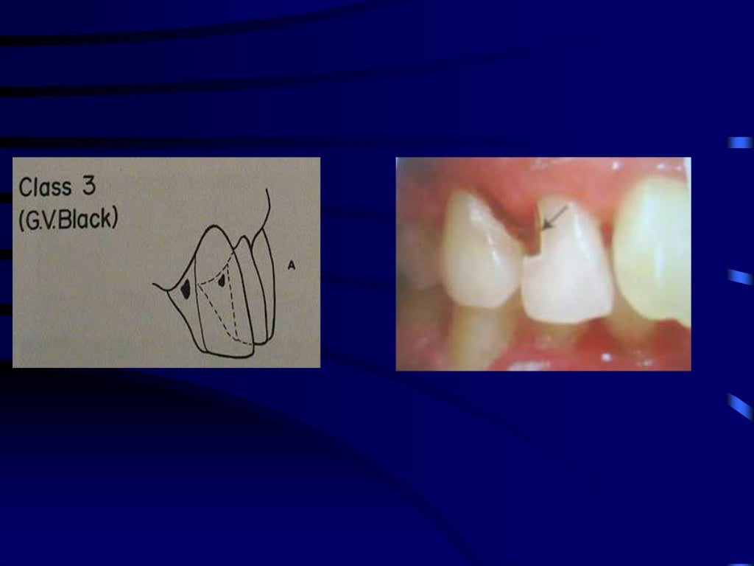

Slide 23
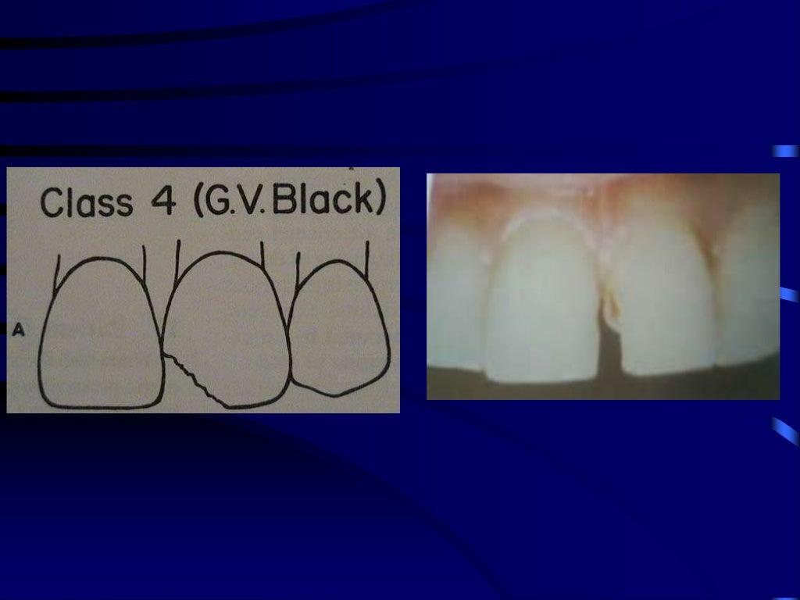

Slide 24
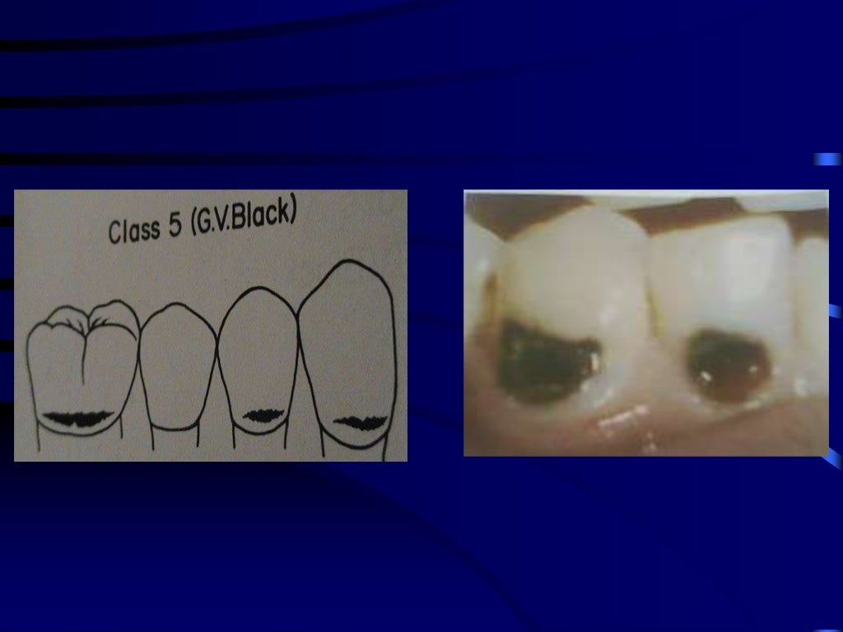

Slide 25
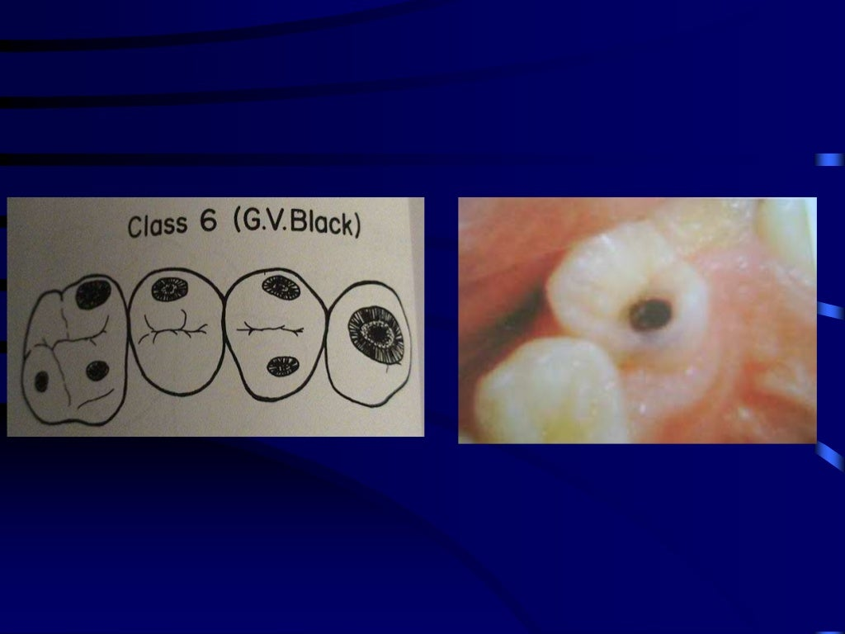

Slide 26
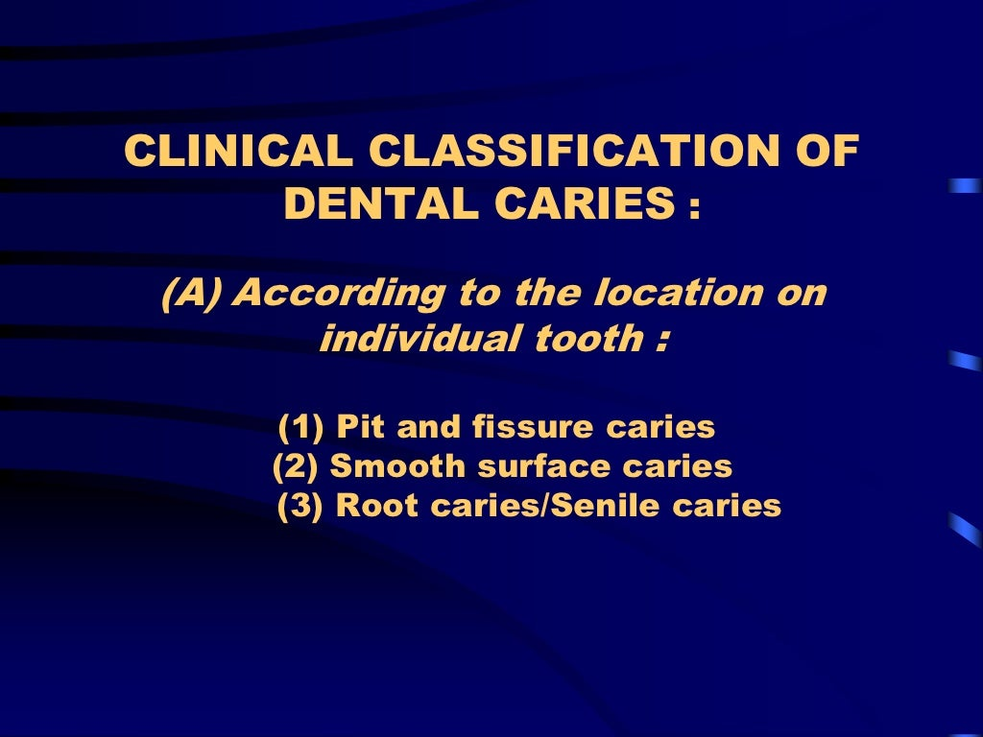

Slide 27
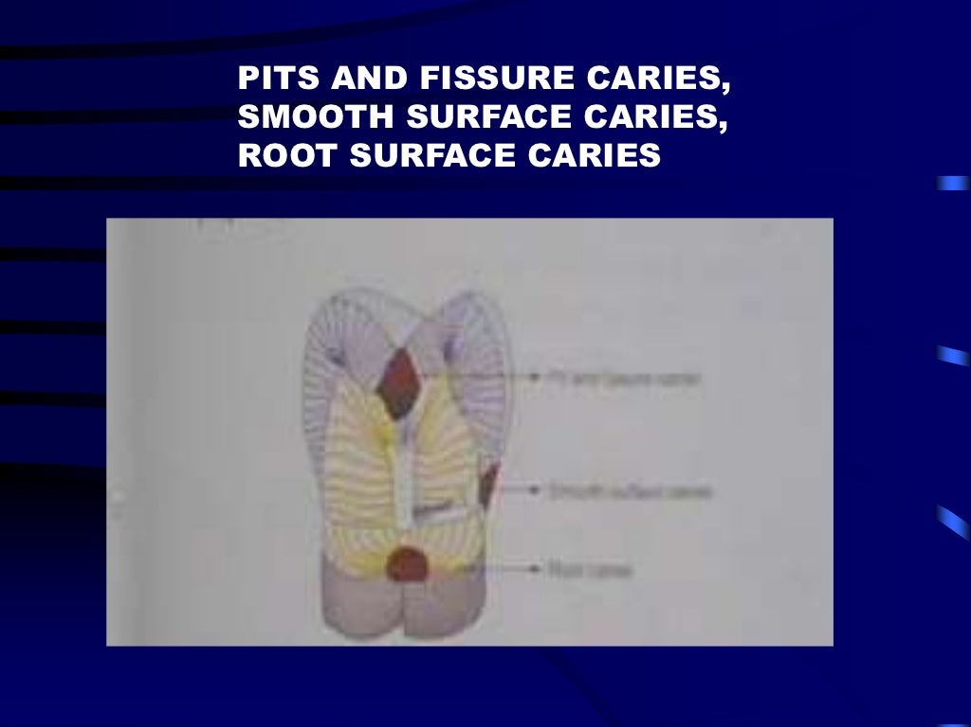

Slide 28
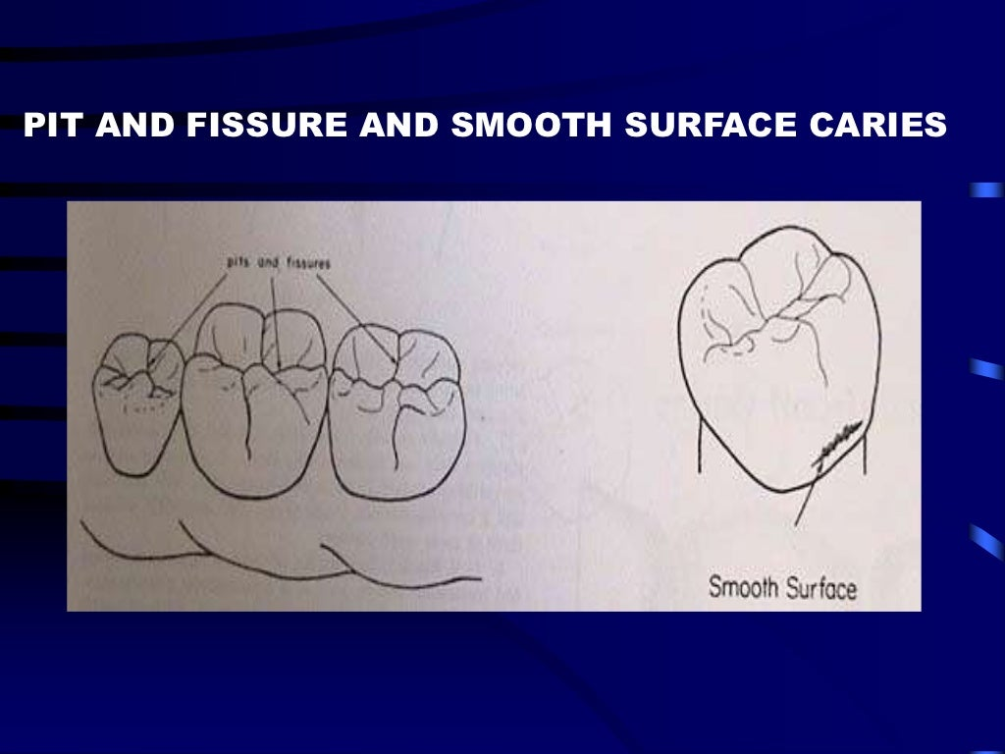

Slide 29
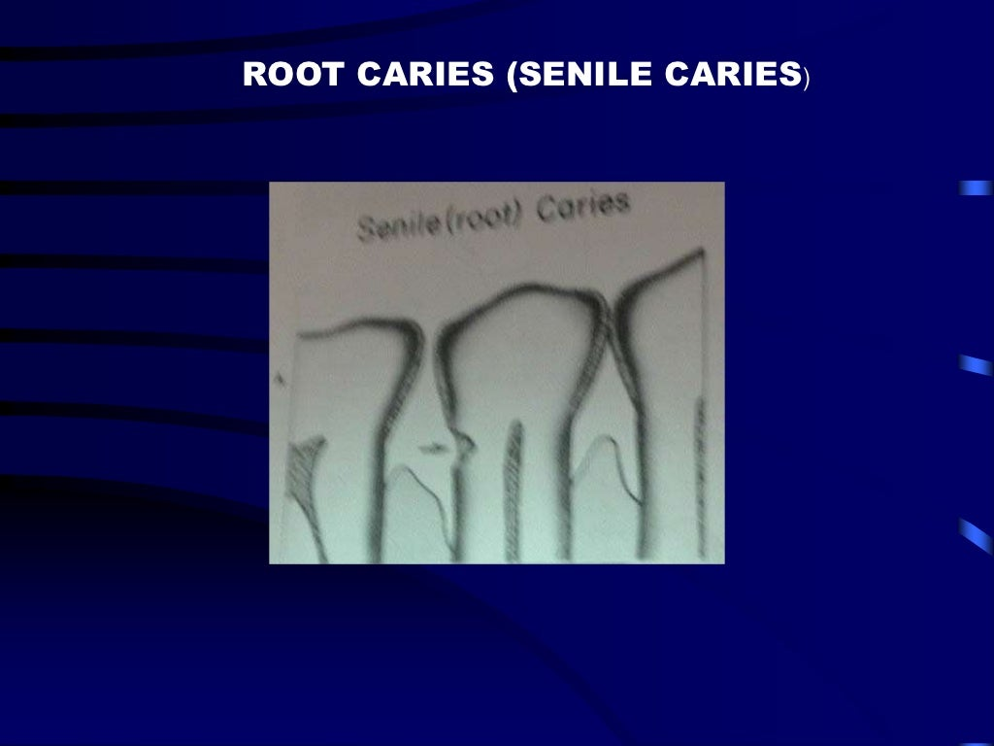

Slide 30
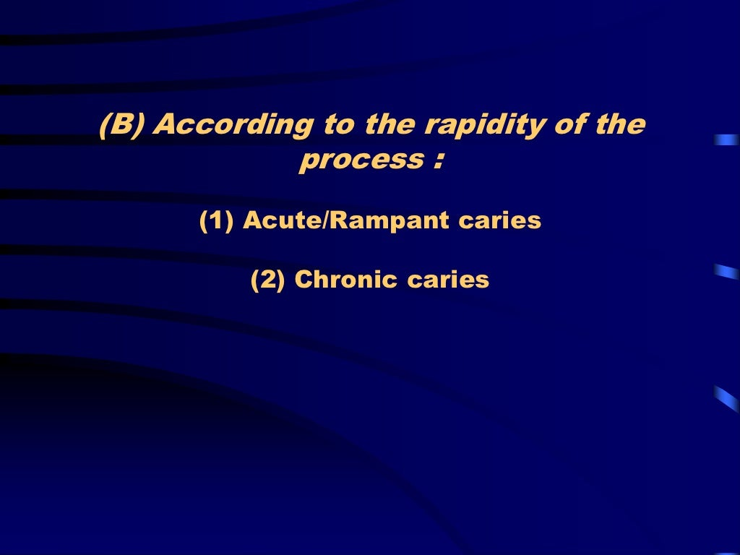

Slide 31
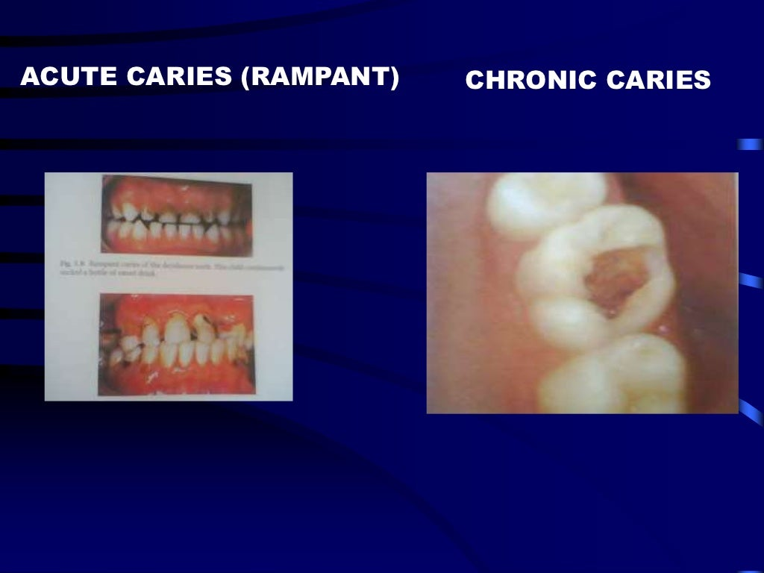

Slide 32
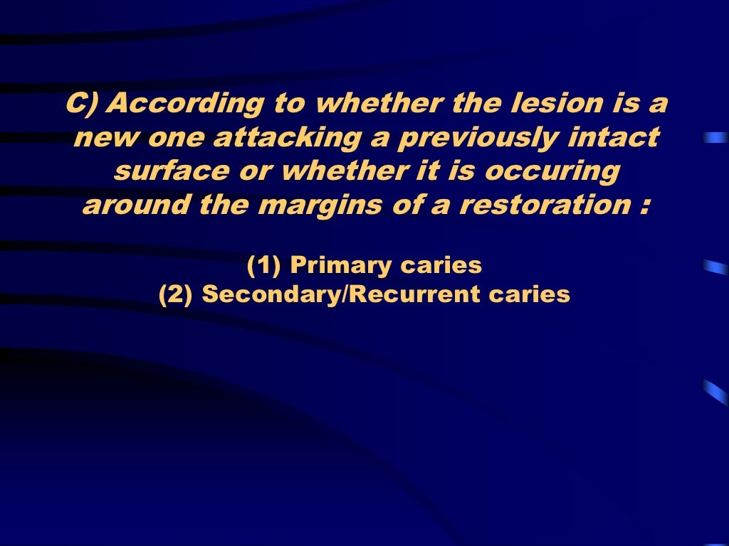

Slide 33
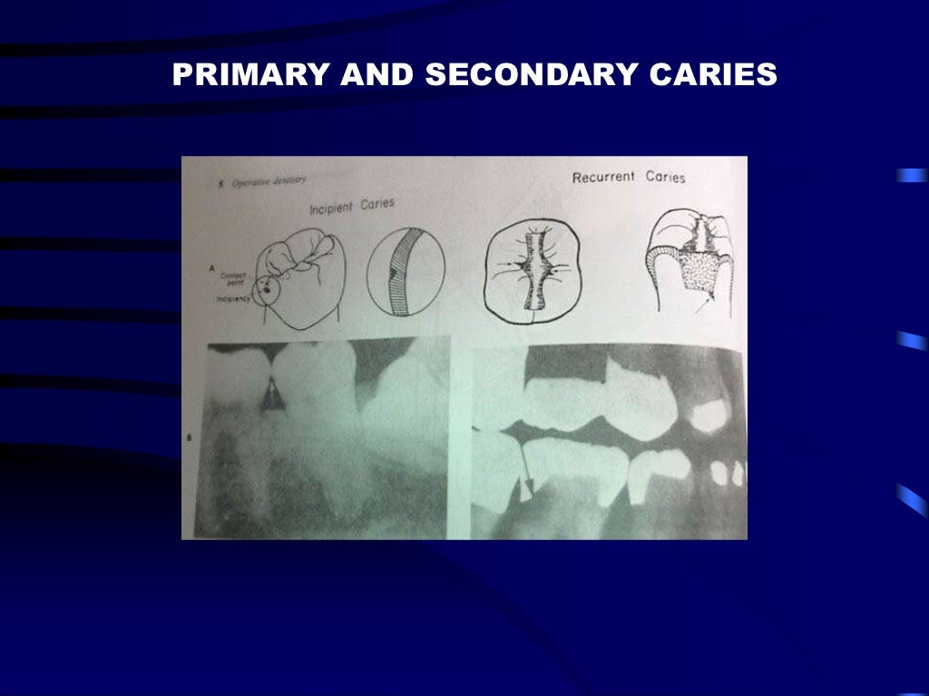

Slide 34
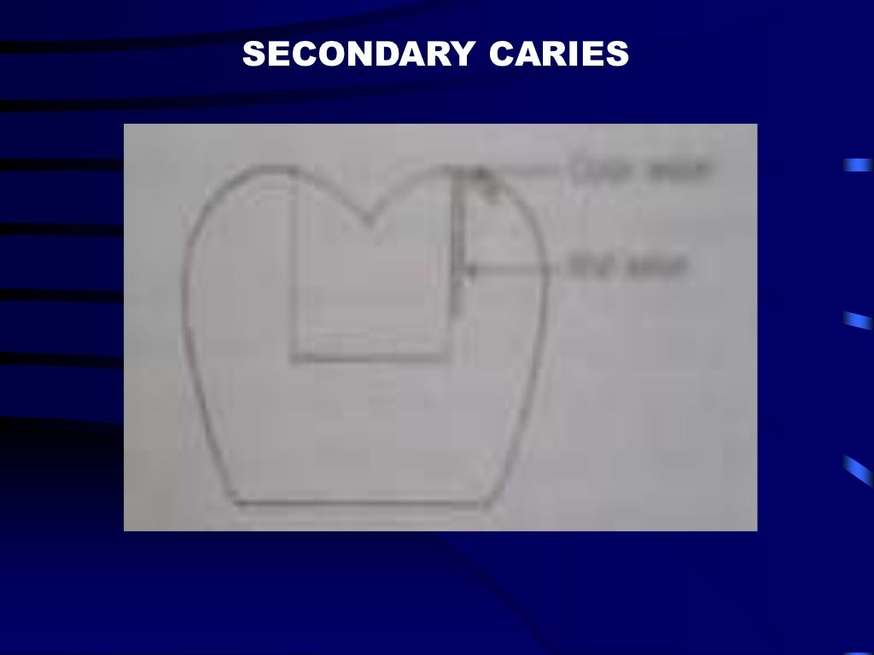

Slide 35
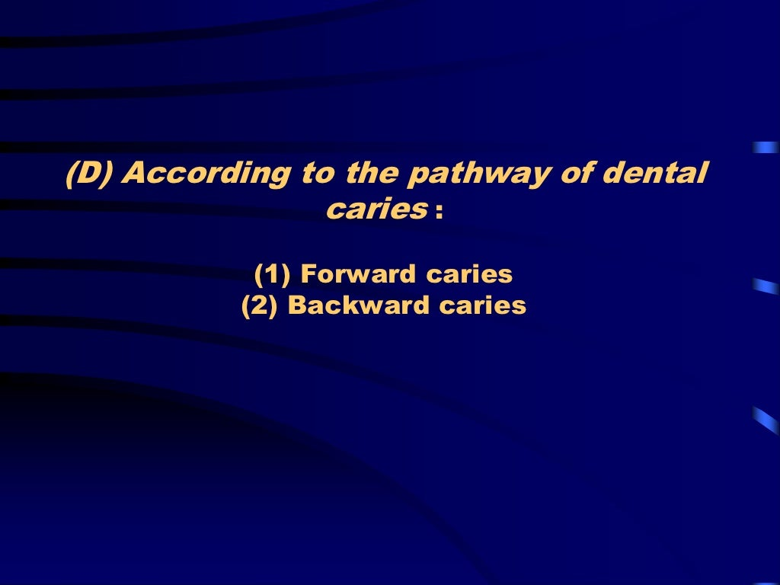

Slide 36
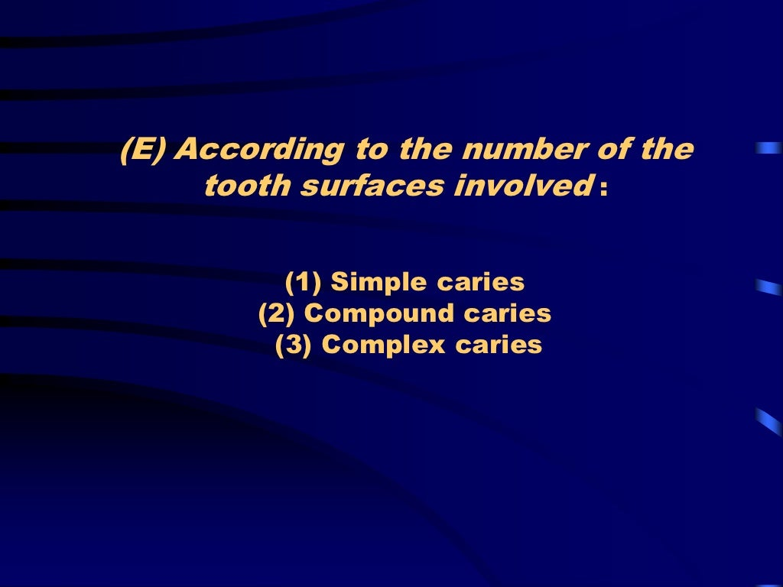

Slide 37
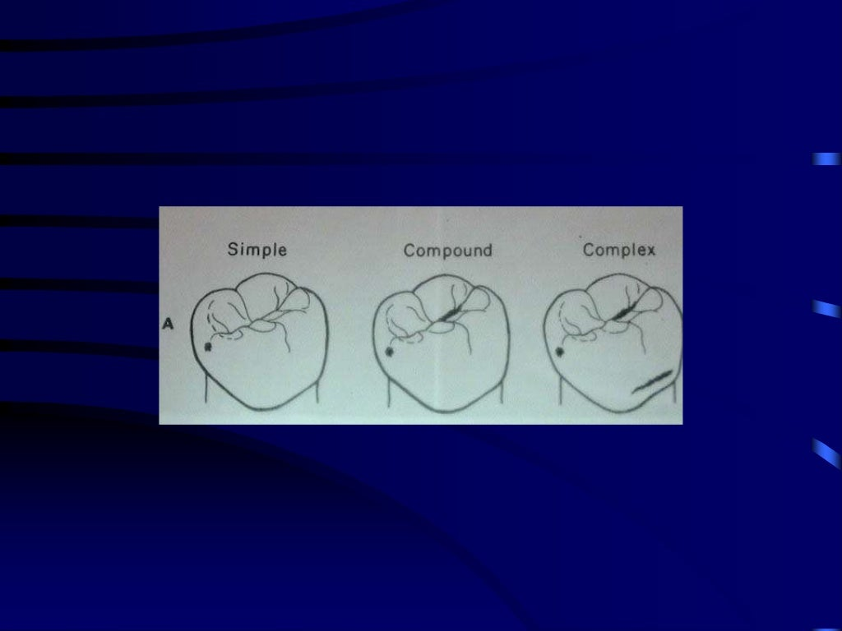

Slide 38
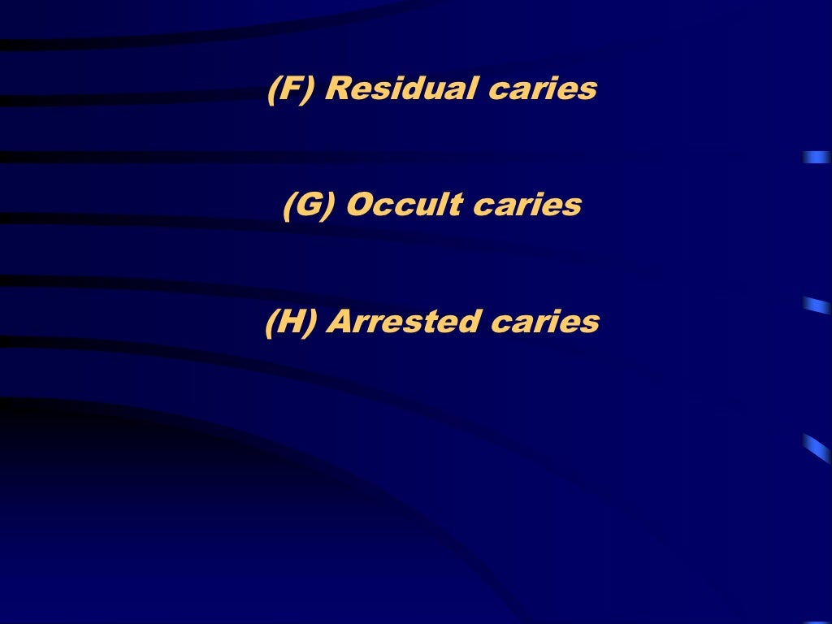

Slide 39
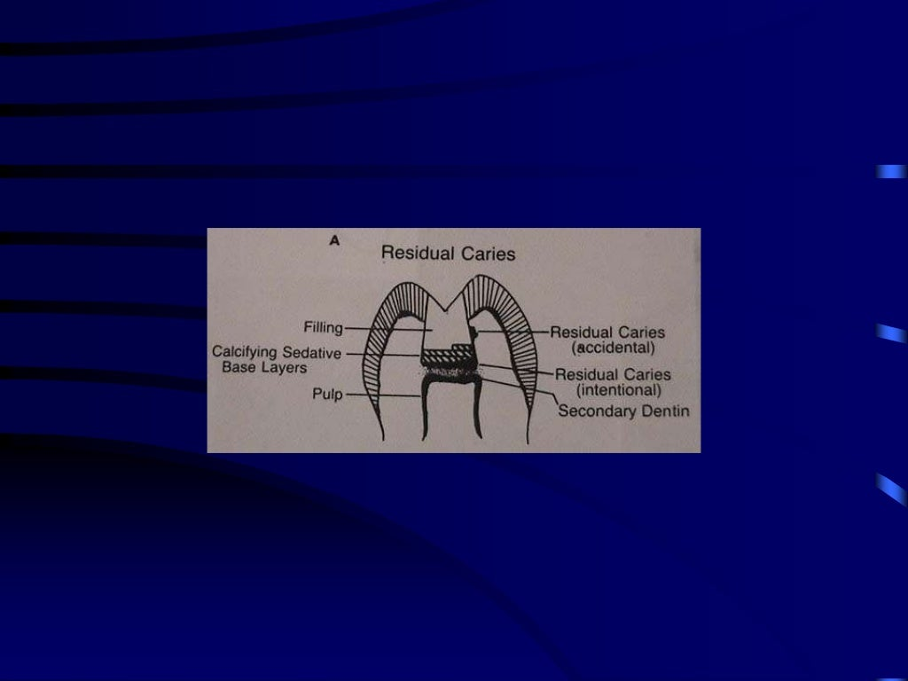

Slide 40
TAKE HOME MESSAGE
Caries is defined as microbial disease of the
calcified tissues of the teeth that leads to
dimeralisation of the inorganic components
and the subsequent breakdown of the
organic matrix of enamel and dentin.
Stephan curve is a graph published by
stephen and miller in 1944 which reflected
the fall in salivary ph following a glucose rinse.
Food sugar substitutes are aspartate ,
saccharine,sucralose,sorbitol,xylitol.

Slide 41


